Slide 1
Introduction (Team 5)
MADHU AKHILESHAM: MANOJ KIMKHABWALA; SUBHAM RAJ
SUNAYANA SALUNKHE; JITENDRA SAMBARE
Mentor : Suvarna Bhonde & Shreepad
Title: Application Development Code Snippet Generator Agent
Problem statement: Developers often need quick code snippets or templates for common programming tasks. Searching documentation or forums can be time-consuming. An AI agent that generates relevant code snippets based on natural language requests can speed up development.
Objective of solution: Quick code snippets or templates for common programming tasks using Agentic based on natural language requests
Date: 29-Aug-2025

Slide 2
Responsible AI Code Generation
Transparency Understand how the model was trained and what data it uses. Be clear about the limitations and potential biases in generated code.
Best Practice Example for a Code Snippet Generator Output
Human-in-the-loop
Security & Reliability AI-generated code can introduce vulnerabilities. Rigorous testing, validation, and human oversight are critical to prevent exploits.
️Fairness & Bias Mitigation Training data may reflect societal biases. If not addressed, generated code could perpetuate discrimination—especially in sensitive applications like finance or healthcare.
👨‍💻 Developer Empowerment vs. Deskilling While AI boosts productivity, over-reliance may erode core coding skills. Developers should stay engaged in design, debugging, and architecture decisions.
🧾 Consent & Compensation Did original code authors consent to their work being used for training? Are they compensated if their code influences commercial outputs? These are emerging ethical questions.

Slide 3
Solution Overview
Claude 3.7 excels in clarity and safety, making it ideal for compliance-heavy environments like FinTech or MedTech.
Gemini 2.5 Pro is unmatched in handling massive codebases and architectural reasoning thanks to its 1M+ token window.
Code LLaMA 70B is your go-to for open-source flexibility and fine-tuning on domain-specific languages.
DeepSeek Coder V2 offers a lean, fast alternative with strong function completion and local deployment options

Slide 4
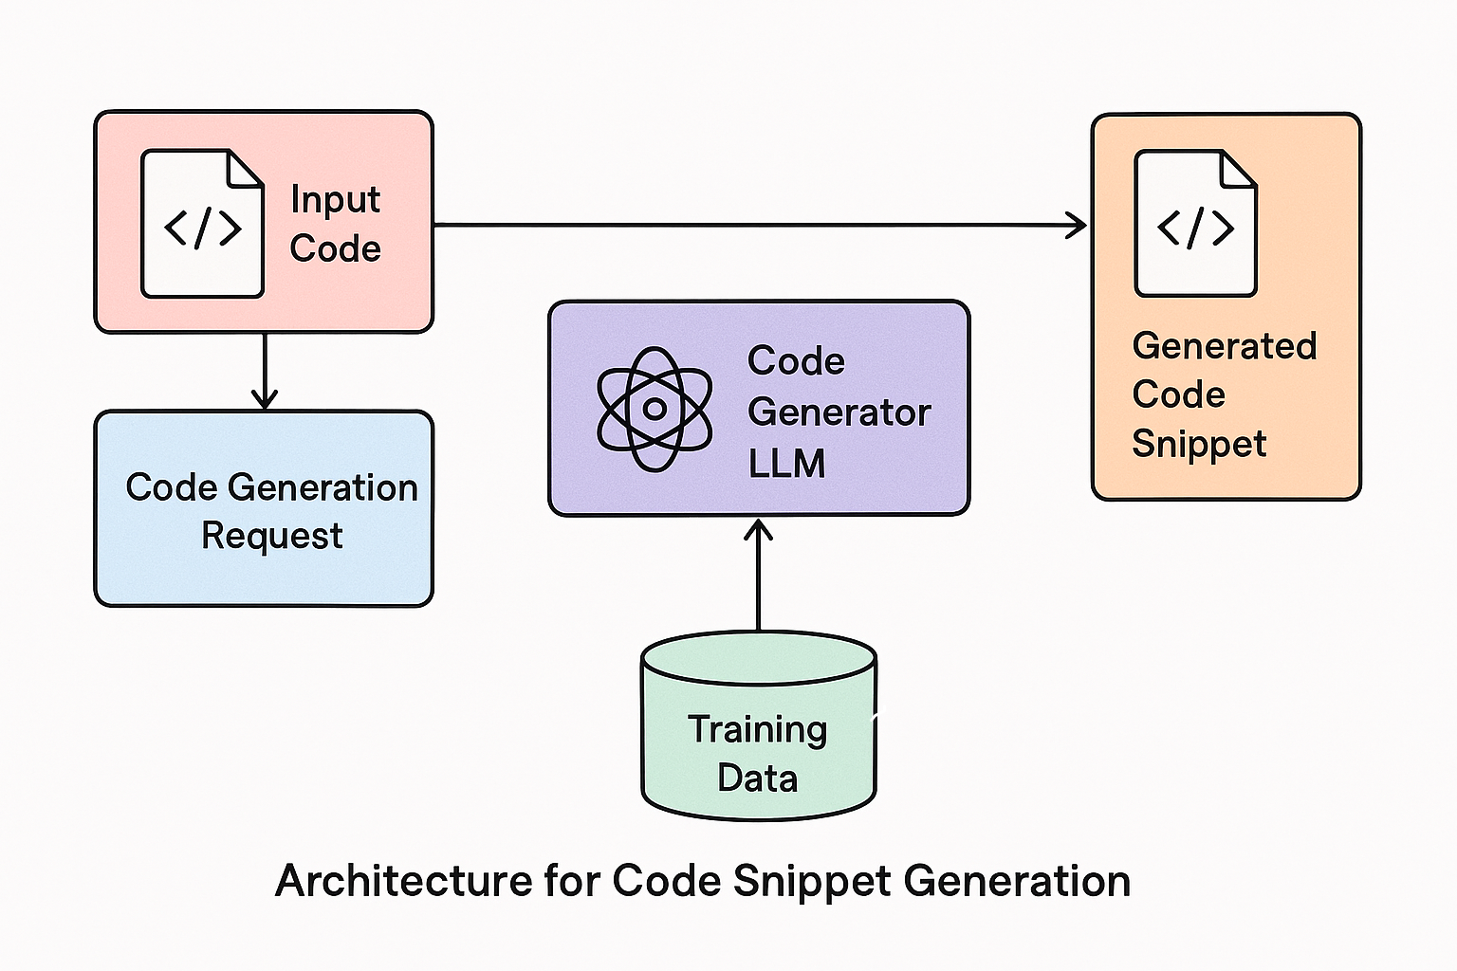
Architecture

Slide 5
Tech Stack
LLMs (GPT-4, Claude, etc.)
Frameworks (Streamlit, Flask, React, etc.)
Libraries (LangChain, Transformers)
Tools (Postman for testing, GitHub for version control, etc.)

Slide 6
Results & Metrics
Accuracy rate of generated code (if measured)
Guardrails - Toxicity
Time saved vs manual snippet search
Number of snippets generated in a session Response Time
Feedback score (if tested with users)
Include a before/after comparison or user testing outcome - Manual testing

Slide 7
Key Outcome
Efficient, real-time code generation from natural language.
Customizability for different languages/frameworks.
Developer productivity boost.
Potential for integration with IDEs or developer tools.

Slide 8
Limitations
Not 100% accurate for complex or niche code.
Limited context memory for multi-turn interactions.
Security concerns in code execution.
Doesn’t learn or adapt over time (if not fine-tuned).

Slide 9
Future Enhancement
Integration with IDEs (VS Code extension).
User feedback loop to improve accuracy.
Support for code execution and testing.
Role-specific code generation (e.g., frontend/backend/devops).
Adding voice command interface.
More Stringent Guardrails

Slide 10
Live Demo

Slide 11
Architecture
High-level architecture diagram.
Key components:
  User Interface / Chat Interface
  Prompt Handling Layer
  Code Generation Engine (GPT/LLM)
  Language/Framework Selector
  Output Formatter
Mention any tools/APIs used (OpenAI, LangChain, vector DBs like Pinecone, etc.).

